Slide 1
What is (are) the key research question(s) that you will seek to answer in your project?
Key research Questions:
What are the weaknesses of tree search algorithms within the GVG-AI competition
What are the best proposed methods of improving their limitations for this competition
Can visualizing the actions an agent may take in the competition lead to insights about the strengths and weakness’ of each tree search algorithm
How can the scaling of different metrics within the competition affect the performance of different tree search algorithms
Could a hyper-heuristic be created from the strengths of multiple tree search algorithms
Hypothesis:
Analysis of different MCTS improvements for GVG-AI
What is the most effective modification to MCTS

Slide 2
How will answering these questions contribute to the state of knowledge in the field of your project?
This research will help gather knowledge into the limitations of different game tree search techniques for AI.
To create a hyper heuristic agent that has been modified from the strengths and weaknesses found in different tree search techniques.
The strengths and weaknesses will be found by visualizing and analyzing the search space of a tree search algorithm.
Also by looking at how the scaling of different metrics within the competition frame work and seeing how they affect the performance of different agents.

Slide 3
Why have you applied particular methods in seeking answers to these questions?

Slide 4
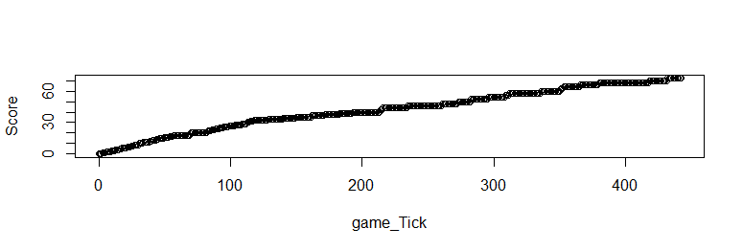
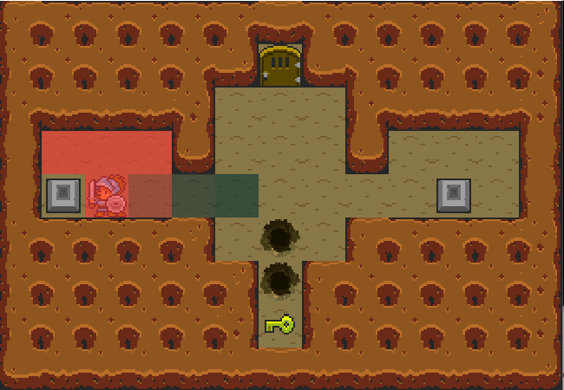
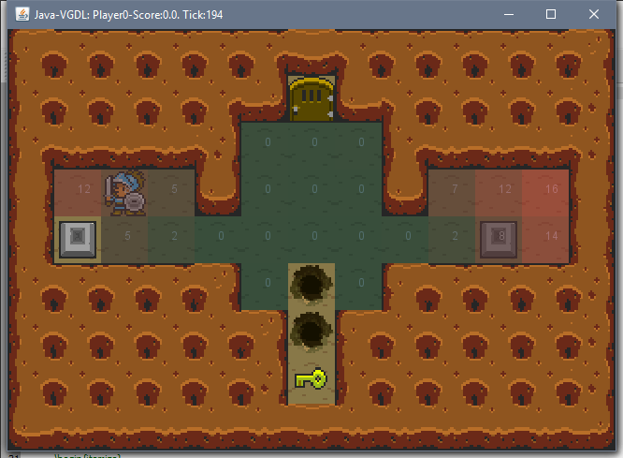
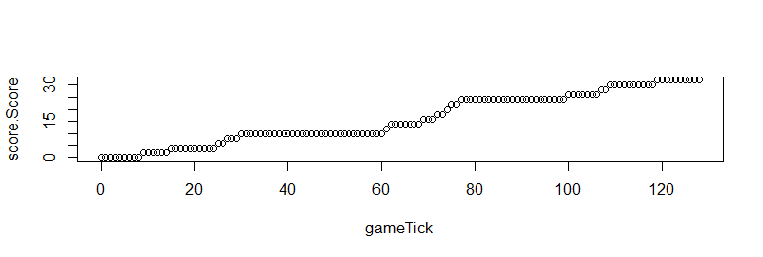
Current Results:
One game played:

Slide 5
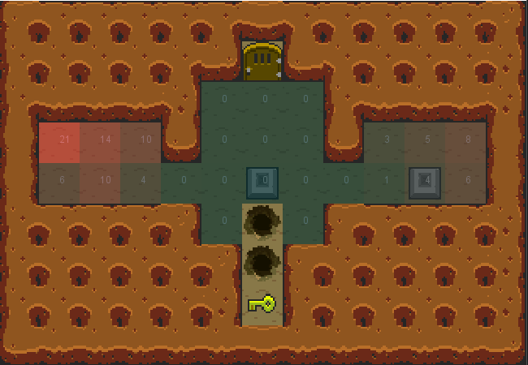
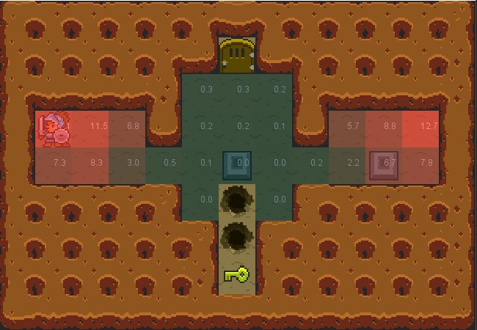
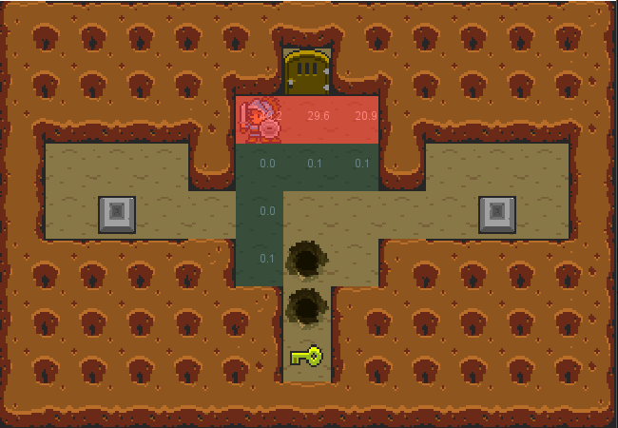
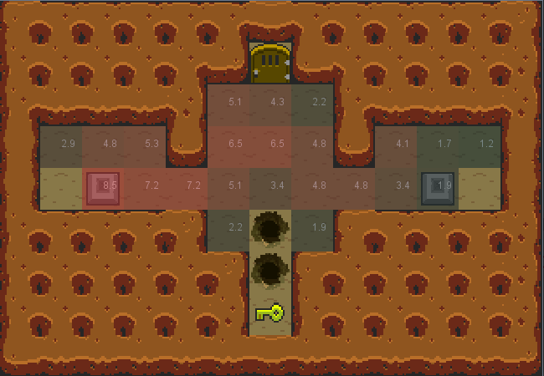
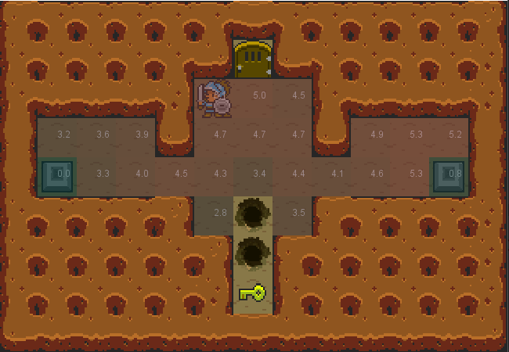
Current Results:
Different MCTS variations:
OLMCTS controller after 10 Games
MCTS controller after 10 Games
FlatMCTS controller after 10 games
Others
Random
OSLA(One Step Look Ahead)

Slide 6
MCTS controller after 10 Games
Random controller after 10 Games

Slide 7
How have you analyzed and interpreted these results?

Slide 8
What are you likely to conclude on the basis of this research?

Slide 9
What are the potential implications of your discoveries?

